Slide 1
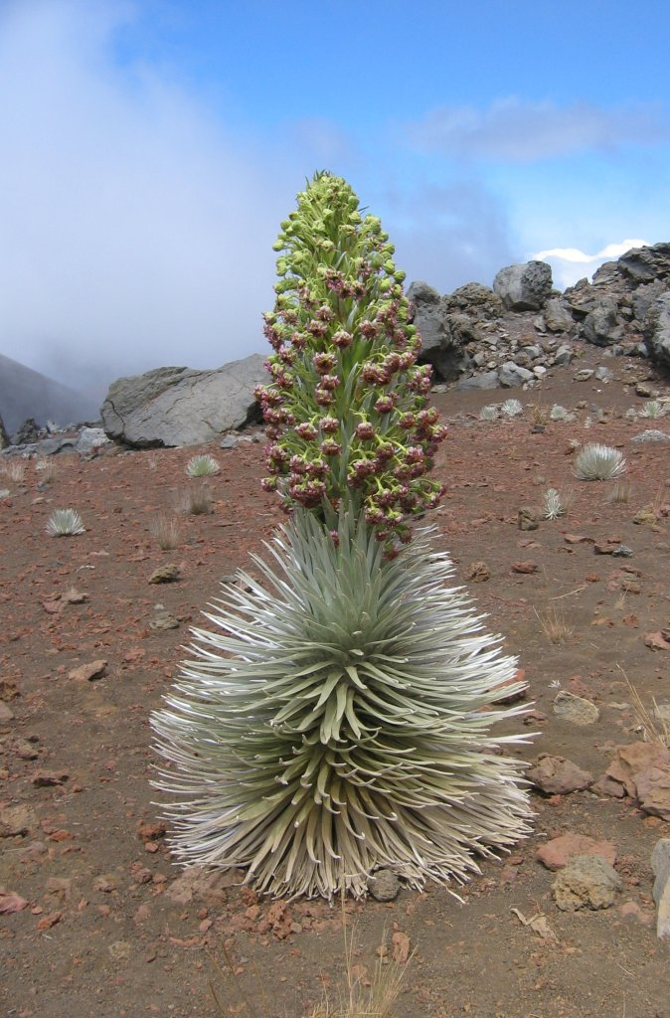
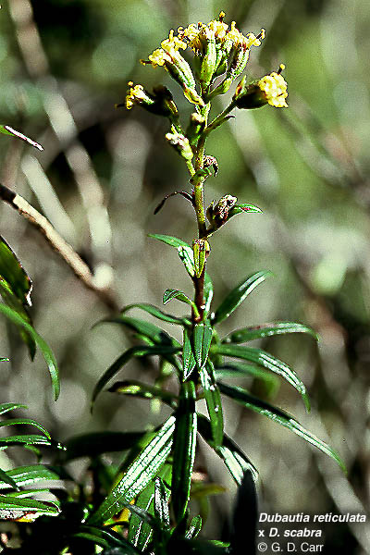
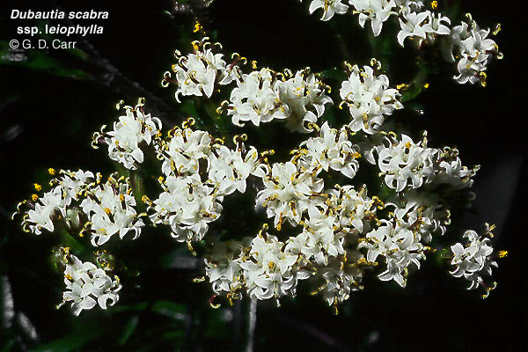
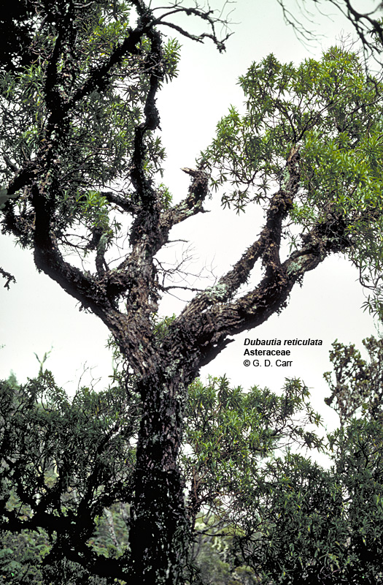
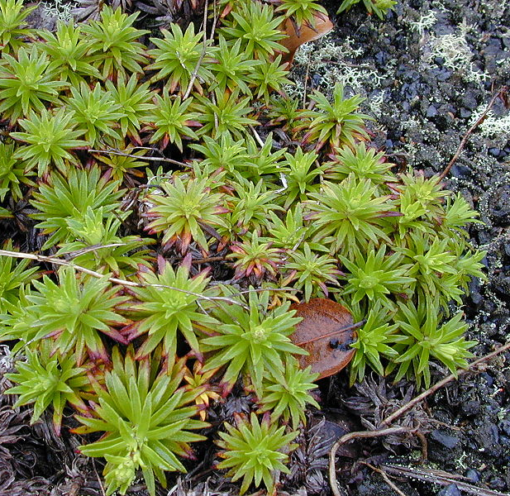
Plants of the day:
Hawaiian Silversword alliance (Madiinae)
all descended from a common ancestor (an annual herbaceous tarweed)
30 species in 4.5–6 Myr
trees, shrubs, mat-plants, cushion plants, rosette plants, lianas
high alpine to near sea level
habitats with <4 to >123 cm annual precipitation

Slide 2
Macroevolution
Definition: evolution at or above the level of the species
Also, long-term trends, biases, or patterns in the evolution of higher taxonomic levels.
Notes:
At a minimum a single speciation event, as we have typically thought of occurring from cladogenesis (reproductive barriers arise, and one species is split into two). But the accumulation of “sufficient” changes within a single species to form a new species, is still considered, especially when looking at fossil data.
(After quote) again we think of macroevolution as occurring between-species, and the importance of patterns and history to this field of study. What I want to emphasize in this lecture is the consequent supreme importance of phylogenetic reconstruction for addressing these kinds of questions.

Slide 3
Big questions in macroevolution
Is evolution gradual or punctuated (characterized by periods of stasis and large “jumps”)?
What are the main drivers of macroevolutionary change?
intrinsic or extrinsic?
biotic or abiotic?
Why are some clades more diverse than others?
How do novel features evolve?
Notes:
So, can anyone remember if we’ve asked any questions like this before in this class?

Slide 4
Diversity at the
macroevolutionary scale
Net diversity =
number of speciation events – number of extinction events
Notes:
A proximate answer is that the balance of speciation and extinction rates in the one sister group results in a higher net diversity. But what is the ultimate answer? What evolutionary processes drive these two rates? What’s important here is that, although these are some of the central questions in macro evolution, there it, at some level, a basic assumption: evolutionary change has some direct correlation with speciation and extinction rates. So, can anyone remember if we’ve asked any questions like this before in this class?
4

Slide 5
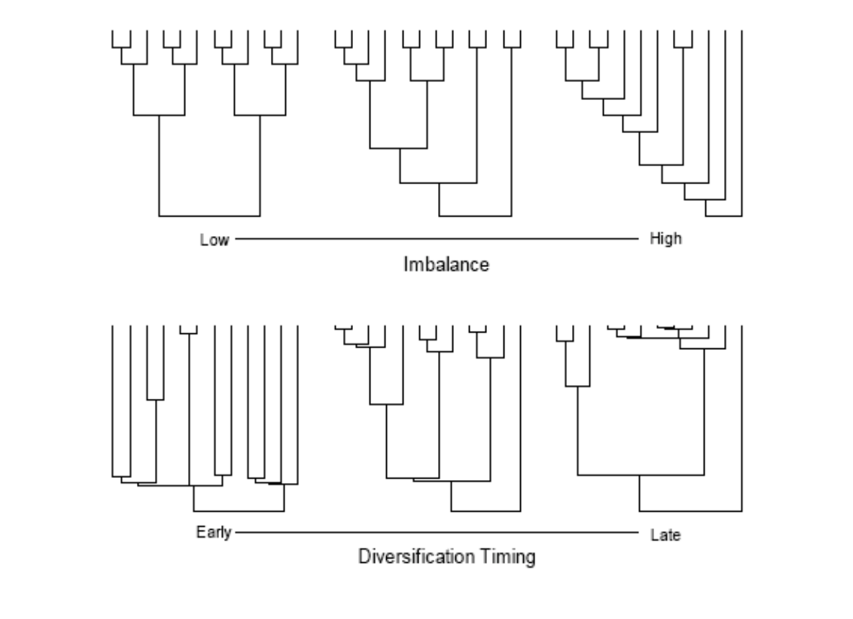
What we can learn from tree shape

Slide 6
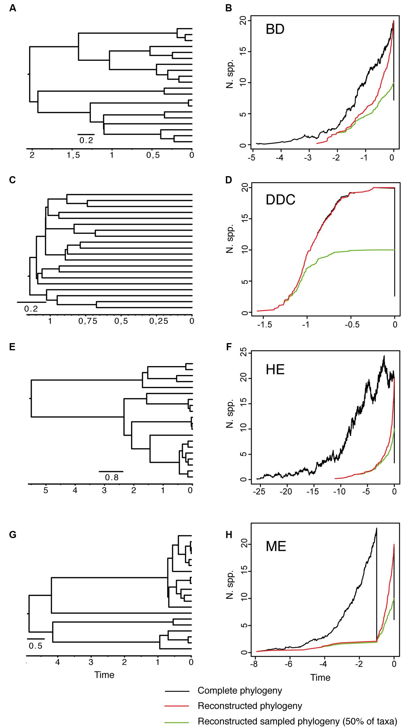
Medium speciation and extinction
Early speciation and very low extinction
High speciation and extinction
Catastrophic event followed by high speciation
Sanmartin and Meseguer, 2016

Slide 7
Diversity at the
macroevolutionary scale
Net diversity =
number of speciation events – number of extinction events
What affects the rates of speciation and extinction?
Notes:
A proximate answer is that the balance of speciation and extinction rates in the one sister group results in a higher net diversity. But what is the ultimate answer? What evolutionary processes drive these two rates? What’s important here is that, although these are some of the central questions in macro evolution, there it, at some level, a basic assumption: evolutionary change has some direct correlation with speciation and extinction rates. So, can anyone remember if we’ve asked any questions like this before in this class?
7

Slide 8
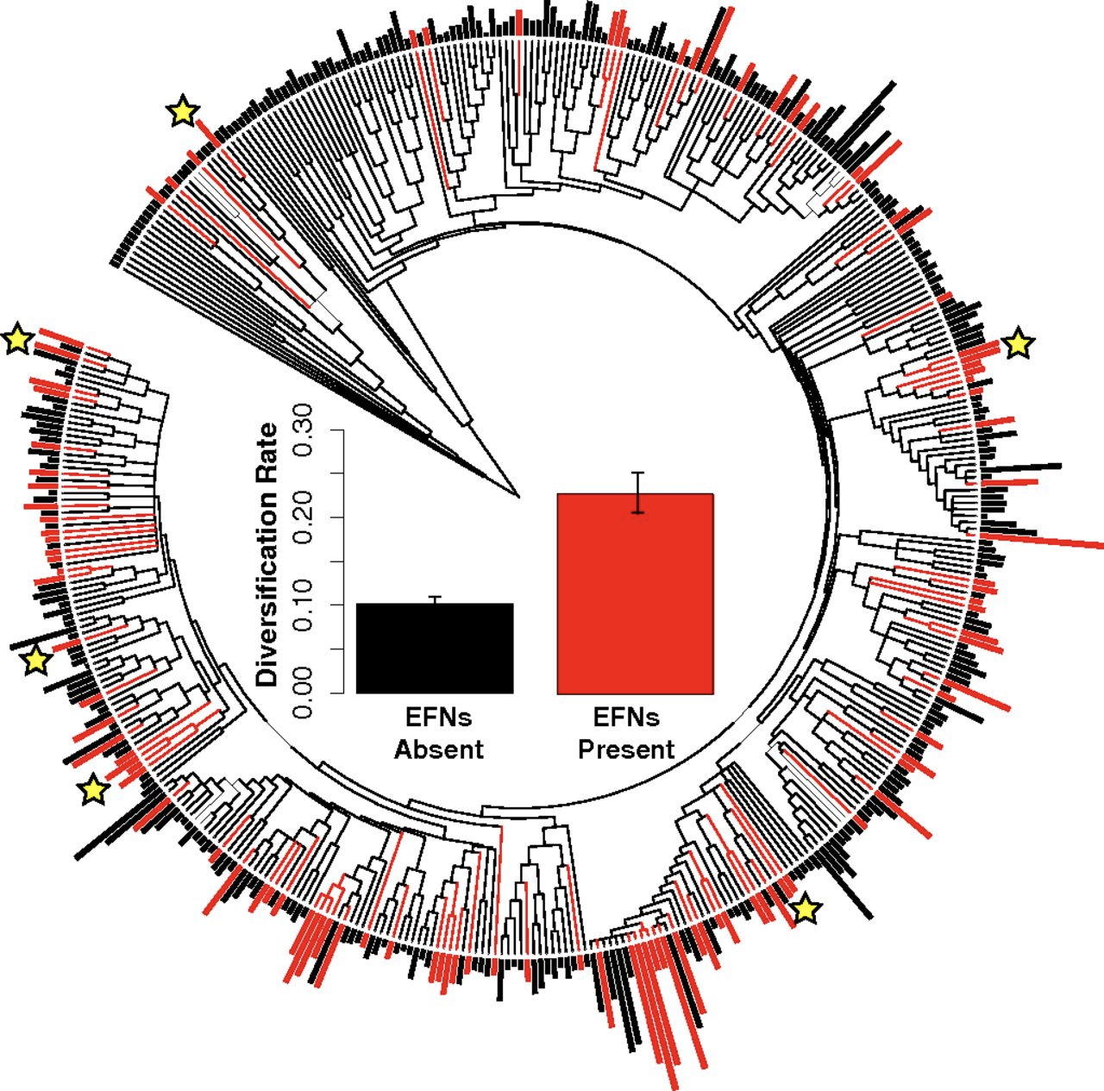
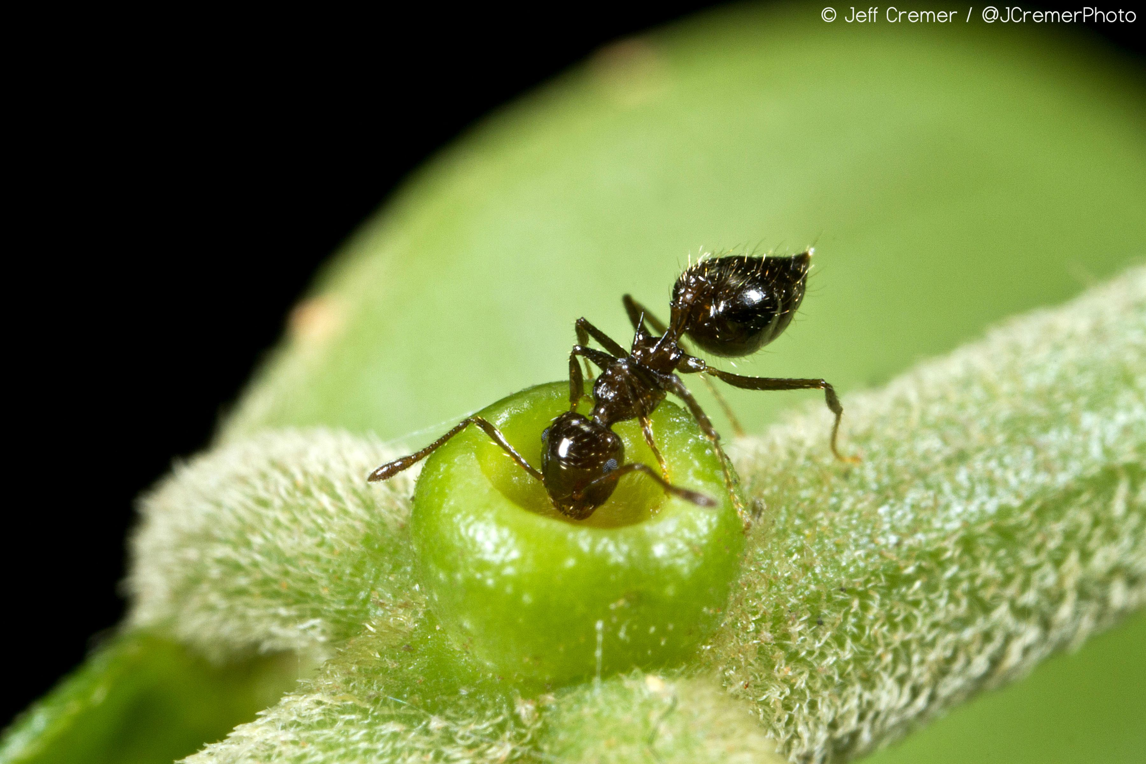
Mutualism promotes diversification
EFN = Extrafloral nectaries
Weber and Agrawal, 2014

Slide 9
What are the main extrinsic drivers of macroevolutionary change?
Physical environment (abotic)
Interaction with other species (biotic)
e.g. Darwin put a lot of emphasis on competition and predation
→ Van Valen’s Red Queen hypothesis
Notes:
External factors to the species may influence diversification rates. But what about the biotic environment? Can interaction with other species also affect diversification rates? Darwin sure seemed to think so. This is in essence the Red Queen hypothesis.
9

Slide 10
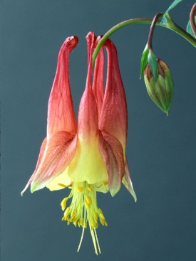
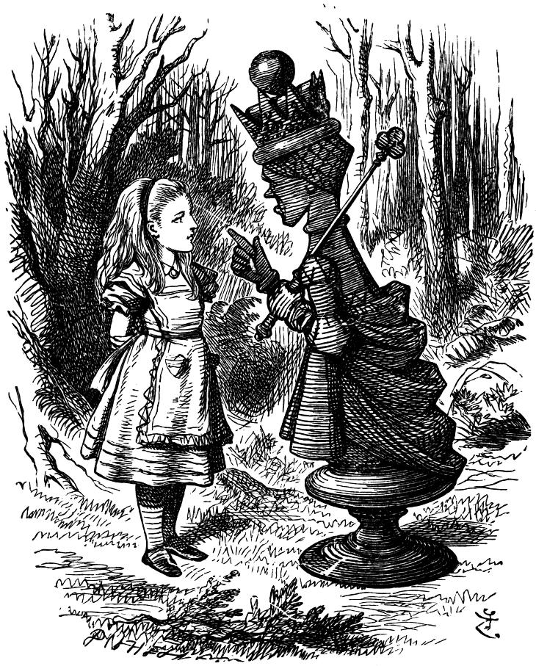
Red Queen hypothesis
Notes:
Who can remind me what this hypothesis states? Van Valen was seeking to disentangle two opposing outcomes of a Darwinian view of adaptation and natural selection: how organisms can be both well adapted and under continuing adaptation. If they are well adapted now, what can natural selection do? On the other hand, if they are currently adapting under natural selection, does this mean that they are currently not adapted, or that they are in some way being improved all the time? If the lion and the antelope now play out their hunt at 20 metres per second, will this speed keep increasing to near-supersonic levels?

Slide 11
Red Queen hypothesis
The continual evolutionary change by a species that is necessary to retain its place in an ecosystem because of ongoing interactions with other species. Food supplies, predators, competitors, pathogens, parasites, and intraspecific dynamics are constantly in flux.
the targets of selection keep changing, and so the organism is never perfectly adapted.
Evidence for the Red Queen includes (from Benton 2009):
interspecific competition
character displacement
evolutionary arms races
incumbency advantage
Notes:
The Red Queen posits steady evolutionary change (even in constant physical environments), resulting in constant speciation and extinction rates.

Slide 12
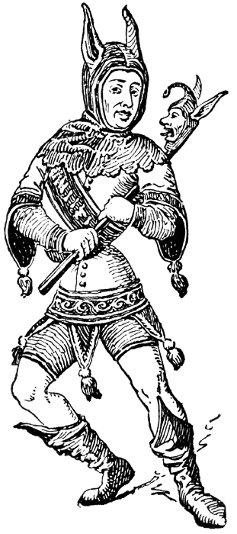
Red Queen vs. Court Jester
An opposing model, the Court Jester, posits that stochastic changes to the physical environment (e.g. climate change, oceanographic or tectonic events) are the key drivers of major changes in organisms and diversity.
Evidence for the Court Jester includes (from Benton 2009):
Mass extinctions (and minor extinctions) linked to stochastic abiotic events (e.g. eruptions, impact, anoxia)
Extinction probability is non-constant
Inverse relationship of biodiversity with global temperature
Variation in diversification rates of clades correlated with tectonic and oceanographic events
These two models are not mutually exclusive.
Notes:
So, the Red Queen hypothesis posits constant evolutionary change, which you can predict would result in gradual evolutionary change and relatively constant speciation and extinction rates. What do you think the Court Jester hypotheses would predict?

Slide 13
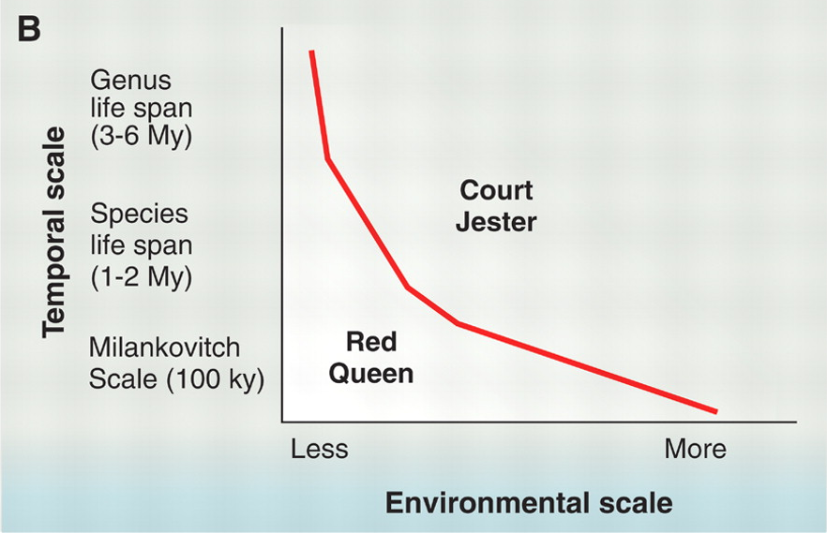
Red Queen vs. Court Jester
Barnosky (2001) suggests that the different models may operate at different spatial & temporal scales
Red Queen works best for short-term, ecosystem-scale processes, but these local patterns may be overwhelmed at larger scales where ‘random geological events’ have large effects
Benton 2009
Notes:
So where does this leave us?

Slide 14
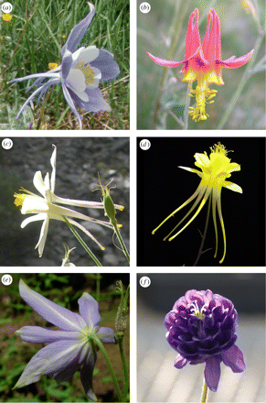
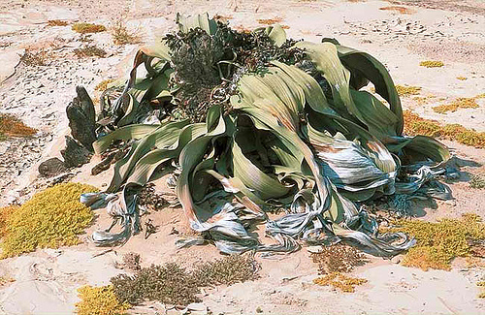
Observation:
there are some particularly diverse, species-rich clades
AND
there are some species-poor clades
Notes:
Here you see two old favorites, Aquilegia, and Welwitschia.

Slide 15
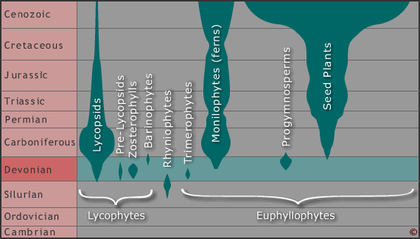
Why are some clades more diverse?
Notes:
One of the major foci of study in macroevolution is understanding patterns of diversity. For example, within the vascular plants different classes have diversified to varying extents over their evolutionary history, and exerted varying amounts of dominance on the ecosystems of their time.
15

Slide 16

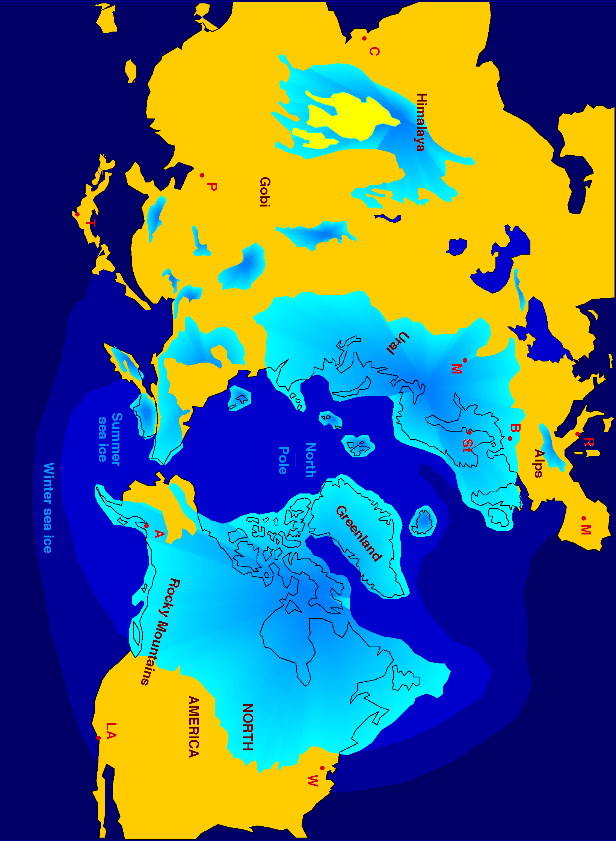
There are at least 3 different reasons for variation in species number between sister groups.
Stochasticity: if speciation is random, then clades with more species are more likely speciate than clades with fewer species
Extrinsic Factors: external factors, such as competition, climate, and geology, can affect speciation and extinction rates
Intrinsic Factors: a single trait, or combinations of traits, can affect a clades’ speciation and extinction rates
Notes:
Give lottery/gambling example. That’s all I will say about stochasticity.
Give environmental harshness example, i.e. relatively high extinction rates at high latitudes limit the number of species there.
Key innovations may influence net diversity in two ways. The character may increase the likelihood that members of the group will undergo rapid speciation (e.g. via specialization, change in breeding system), or it may increase the population size or increase the species range (decreasing extinction risk). Or both! Hence, it can enhance speciation rates directly or indirectly (by allowing species to persist long enough to undergo numerous rounds of speciation).

Slide 17
Adaptive radiation: the evolution of ecological diversity within a rapidly multiplying lineage
George G. Simpson (famous paleontologist, founder of the modern synthesis) first described this term.
Adaptive radiations result from diversification accelerated by ecological opportunity
- new environment
- extinction of competitors
- new way of life (e.g. key innovations)
Notes:
Simpson’s perspective is echoed by Verne Grant (a muse of Loren’s!).

Slide 18
This view is echoed by Verne Grant…
“When a species succeeds in establishing itself in a […] new habitat, it gains an ecological opportunity for expansion and diversification. [It] may respond to this opportunity by giving rise to […] daughter species adapted to different niches within the territory or habitat. These daughter species become the ancestors of […] new daughter species. The group enters its second phase of development, the phase of proliferation.”
“Adaptive radiation is the pattern of evolution in this phase of proliferation. And speciation is the dominant mode of evolution in adaptive radiation.” (1977: p. 309)
Notes:
There are some caveats to this perspective.

Slide 19
Identifying adaptive radiations
Criteria from Schluter 2000:
single common ancestor of component species
increase in speciation rate
associated increase in ecological and phenotypic diversity
phenotypes must be correlated with environments and increase fitness in “home” environment
Notes:
Organisms create their own niches based on their own specific suite of traits. Opportunities may only be taken advantage of, if species have sufficient genetic variation.

Slide 20
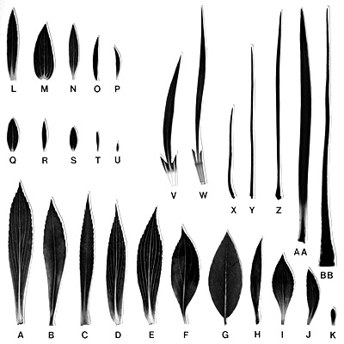
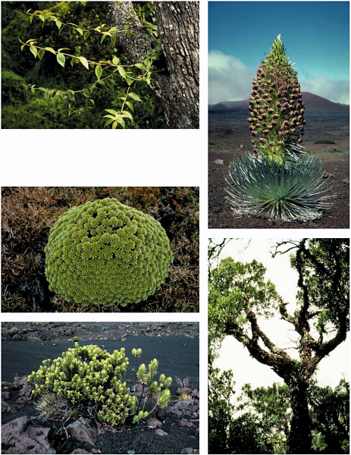
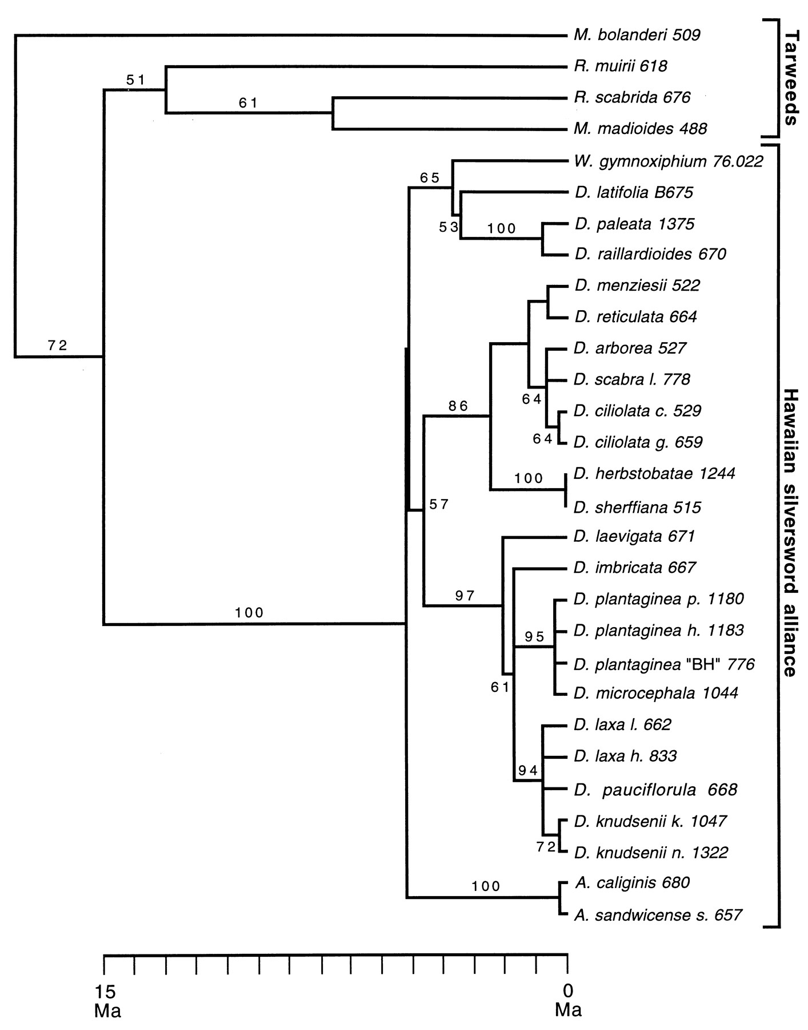
← dry & open
← wet & shady
G
F
The Hawaiian silversword alliance: “the greatest living example of adaptive radiation in plants” (Schluter 2000, p. 27)
Notes:
And they occupy different ecological niches, as shown by the relatively non-overlapping ranges of species for mean annual rainfall and elevation.

Slide 21
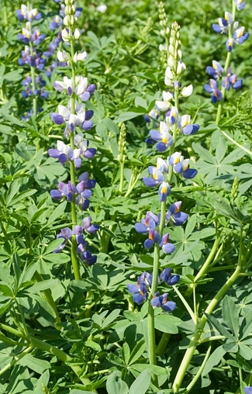
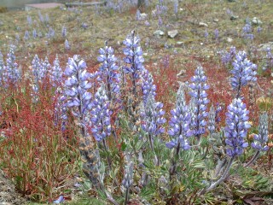
Andean lupines
Andean uplift
between 2 and 4 Myr ago
created ecological opportunities for diversification
80 species in 1.2–1.8 Myr
Notes:
Lack of key innovations
Andean uplift between 2 and 4 Myr ago
The Andean clade is estimates to be 1.18 to 1.76 Myr old
21

Slide 22
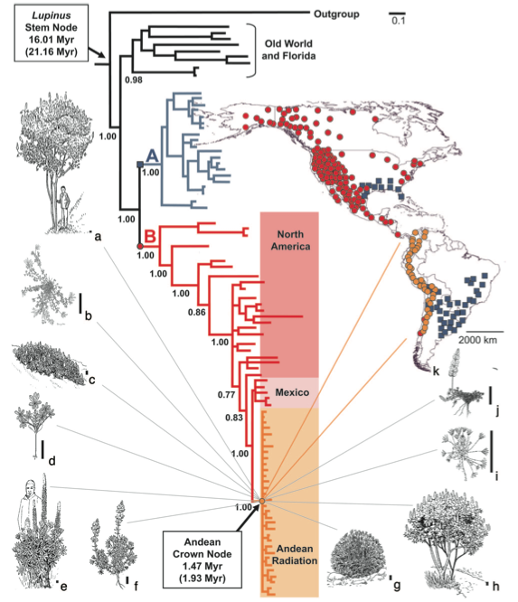
Notes:
Lack of key innovations
22

Slide 23
Adaptive radiation
Caveats:
Few examples of strong causal relationships between rapid levels of adaptive diversification and speciation
genes underlying adaptive differences must be linked to/the same as those responsible for isolation
at minimum, ecological speciation has been documented in plants (e.g. sago palms, pollinator isolation in Aquilegia )
The environment is not divided into predetermined niches in the absence of the organisms that inhabit them
Notes:
Organisms create their own niches based on their own specific suite of traits. Opportunities may only be taken advantage of, if species have sufficient genetic variation.

Slide 24
(Non-)adaptive radiations
Criteria from Schluter 2000:
common ancestor of component species
increase in speciation rate
associated increase in ecological and phenotypic diversity
phenotypes must be correlated with environment and also increase fitness
Notes:
Organisms create their own niches based on their own specific suite of traits. Opportunities may only be taken advantage of, if species have sufficient genetic variation.

Slide 25
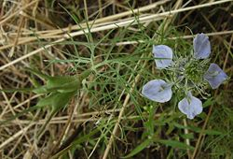
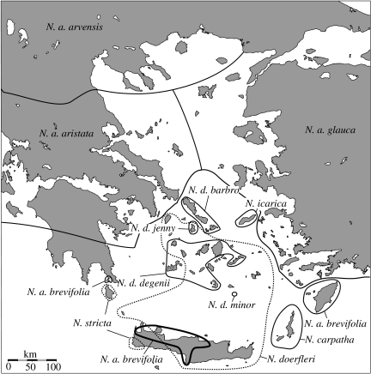
Non-adaptive radiation: rapid speciation in the absence of ecological diversification
e.g. Aegean Nigella arvensis complex
12 taxa
similar habitats on different islands
changes in sea level allow dispersal, selfing
So, what likely drove this radiation?
Comes et al. 2008
Notes:
In the absence of ecological diversification, we might propose that the evolution of reproductive isolation has likely occurred through genetic drift.

Slide 26
Intrinsic Factors: Key innovations
Key innovations are novel phenotypic traits thought to open new ‘adaptive zones’ (the ability to exploit new niches) or to increase diversification rates by decreasing extinction and/or increasing speciation rates.
Notes:
Many radiations are thought to be linked to the occurrence of one or more key innovations.
26

Slide 27
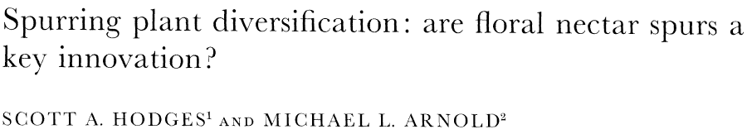
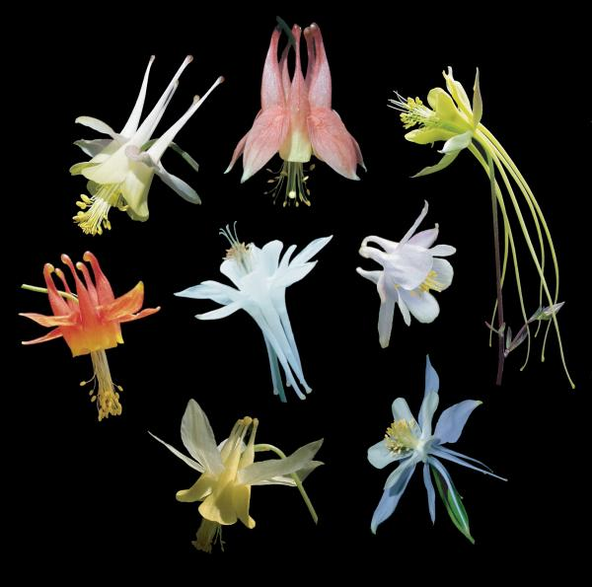
Notes:
We’ll talk about one potential key innovation in tutorial today.
27

Slide 28
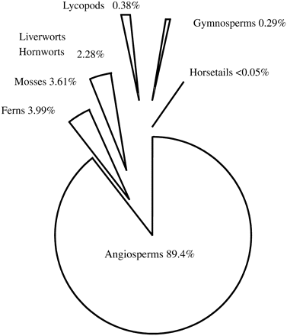
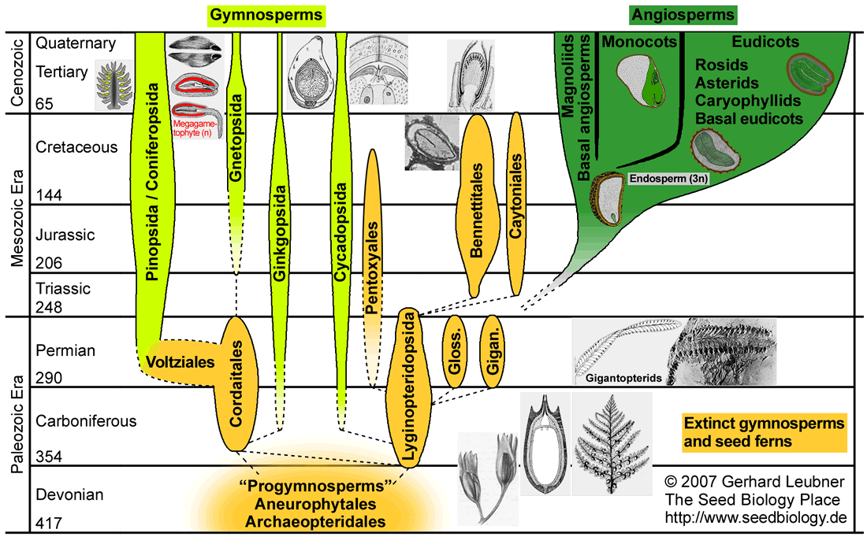
Why are the angiosperms so species rich?
~90% land plants are angiosperms
Incredibly ecologically and phenotypically diverse
Crepet and Niklas 2008
Notes:
The flowering plants are one of evolution’s biggest success stories. According to the fossil record and to the vascular plant super tree, it took only 25-27 million years for all the major angiosperm lineages to appear on, and then dominate, the terrestrial landscape.
28

Slide 29
“The rapid development as far as we can judge of all the higher plants within recent geological times is an abominable mystery[...] I should like to see this whole problem solved. I have fancied that perhaps there was during long ages a small isolated continent in the S. hemisphere which served as the birthplace of the higher plants—but this is a wretchedly poor conjecture.”
—Excerpt of a letter written by Charles Darwin on 22 July 1879 to Joseph Hooker

Slide 30
Solving Darwin’s Abominable Mystery
THINK PAIR SHARE
Could the angiosperms represent an adaptive radiation driven by one or a complex of key innovations?
If so, can we identify the key innovations (angiosperm synapomorphies)?

Slide 31
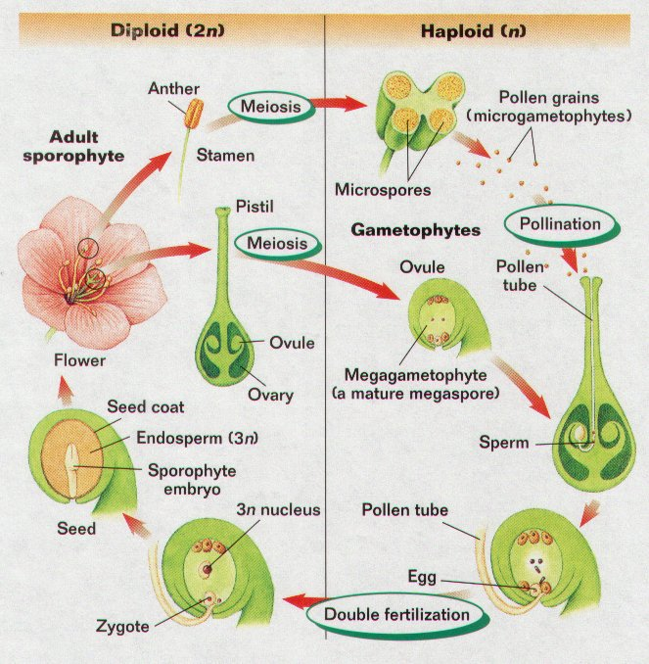
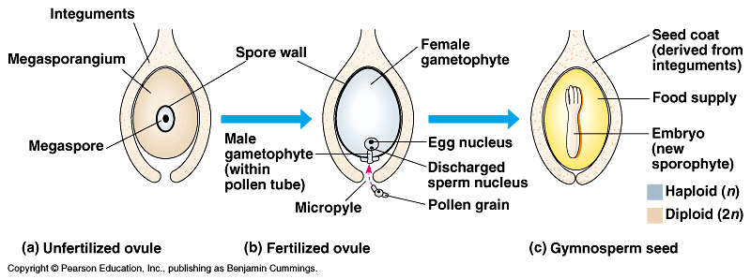
Distinguishing reproductive angiosperm characteristics
Closed (angio-)carpels and sperm
Double fertilization
Endosperm
Rapid embryogenesis
versus
Notes:
helps to prevent self-fertilization,
fruit often serves as an attractant to seed-dispersing animals
The pollen tube must grow through the megasporophyll (style portion) to get to the ovule. As a result, a range of incompatibility mechanisms have evolved to control what pollen grain is allowed to germinate on the stigma, what pollen tubes are permitted to grow through the style and ultimately what male gamete will fuse with the egg
31

Slide 32
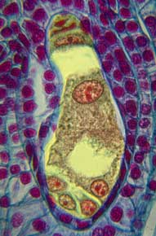
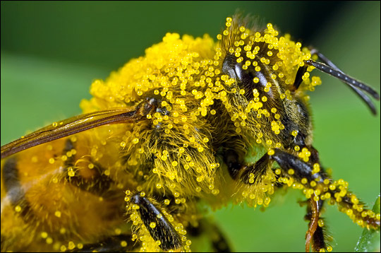
Distinguishing reproductive angiosperm characteristics
(5) Reduced male and female gametes
Notes:
The male gametophyte (pollen) in angiosperms is significantly reduced in size compared to those of gymnosperm seed plants. The time from pollen dispersal to fertilization is faster and seed set is sooner.
The reduced female gametophyte, like the reduced male gametophyte, may be an adaptation allowing for more rapid seed set.
32

Slide 33
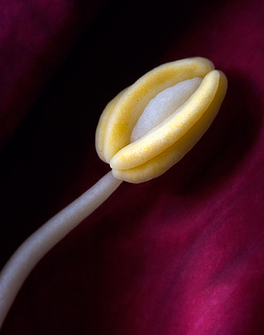
Distinguishing reproductive angiosperm characteristics
(6) Stamens with two pollen sacs (and other mechanisms) facilitate specialized pollination syndromes
Notes:
Facilitate specialized pollination syndromes. Prevent self-fertilization.
33

Slide 34
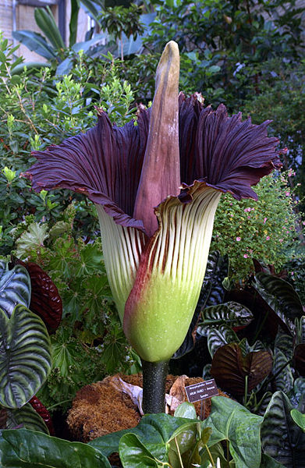
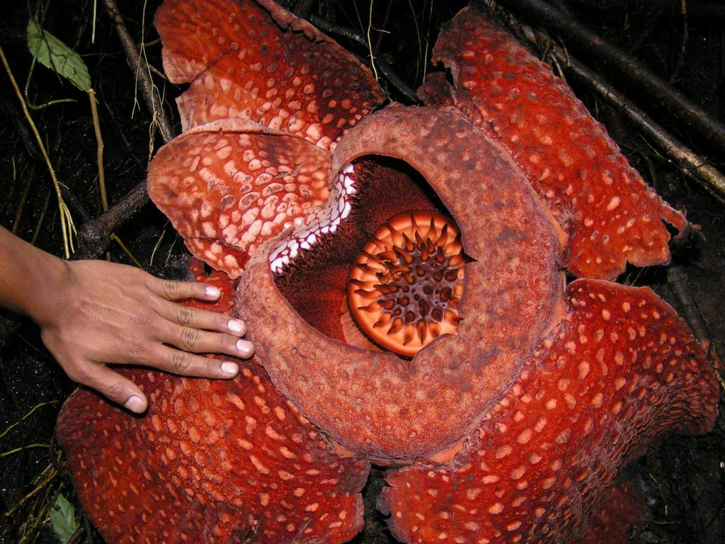
Distinguishing reproductive angiosperm characteristics
(7) Flowers and the biotic interactions they represent
Notes:
Flowers aid angiosperms by enabling a wider range of adaptability and broadening the ecological niches open to them.
Co-evolutionary dynamics
34

Slide 35
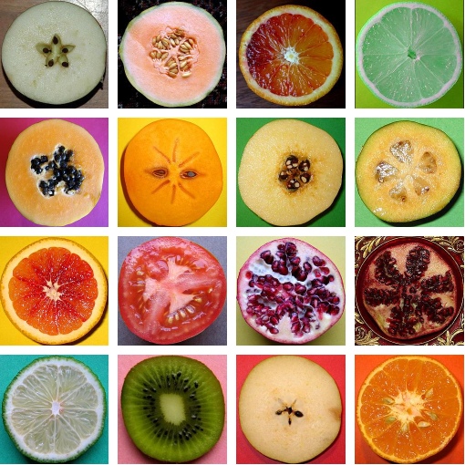
Distinguishing reproductive angiosperm characteristics
(8) Edible or other animal-dispersed fruits and the biotic interactions they represent
Notes:
35

Slide 36
Distinguishing vegetative
angiosperm characteristics
Herbaceous growth form
- shorter generations
- rapid growth rates
Diverse developmental morphologies and extensive phenotypic plasticity
Novel conductive morphology (vessel elements)
Litter is more easily decomposed → increased soil nutrient release
Novel chemical pathways and interactions
Notes:
36

Slide 37
So many angiosperms!
Rest of the angiosperms
> 250000
Gnetales
69
Ceratophyllaceae
6
Angiosperm synapomorphies, possible “key innovations”
Notes:
When we look in the context of the phylogenetic tree, the angiosperms are clearly the odd class of plants. Think back to the diagram with the gymnosperms & angiosperms.

Slide 38
So many angiosperms!
Rest of the angiosperms
> 250000
Gnetales
69
Ceratophyllaceae
6
Angiosperm synapomorphies, possible “key innovations”
Notes:
Burst of diversification occurred within the angiosperms themselves, not at the time of the synapomorphies.

Slide 39
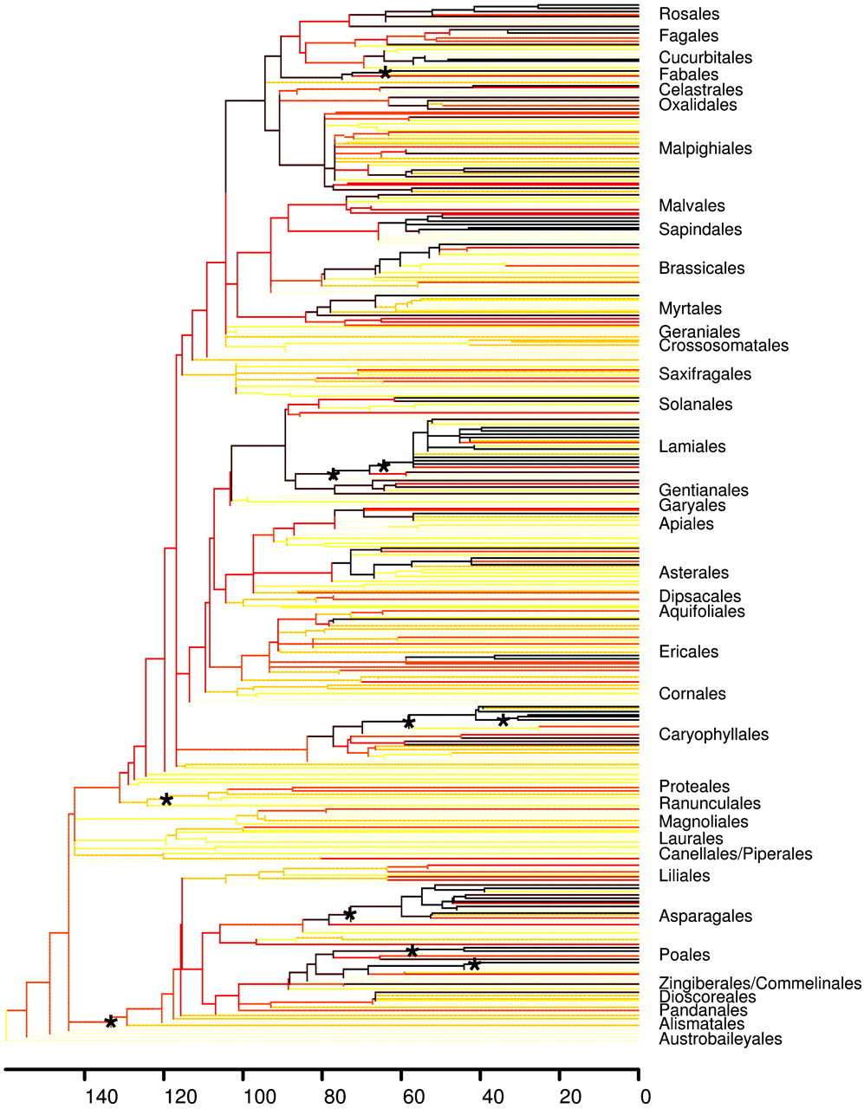
Diversification rates on the angiosperm super-tree
Strength of shading indicates diversification rate
yellow to orange = low
red to black = high
* = top 10 imbalanced nodes
No simple correlations.
Davies et al. 2003

Slide 40
Difficulties in identifying key innovations
multiple innovations may work together to affect diversification, a key “complex”
the effects of innovations may be obscured over time by the evolution of other characters or the loss in some lineages
timing of evolution of trait and diversification “burst” may involve a lag or delay
requires accurate timing of character evolution and well-resolved phylogenies
Notes:
Otherwise correlation not causation!

Slide 41
Conclusions
There is no simple key innovation involved in the angiosperm radiation, but many possible with varying levels of support.
The picture is more dynamic than a single origin of one key innovation & subsequent diversification.
Innovations have likely been gained and lost within the Angiosperma.

Slide 42
unanswered questions
Is evolution gradual or punctuated?
Is evolution primarily driven by biotic or abiotic factors?
Is evolution repeatable?
“replaying the tape of life”

